Slide 1
Object-Oriented System Modeling and UML Models and Views

Slide 2
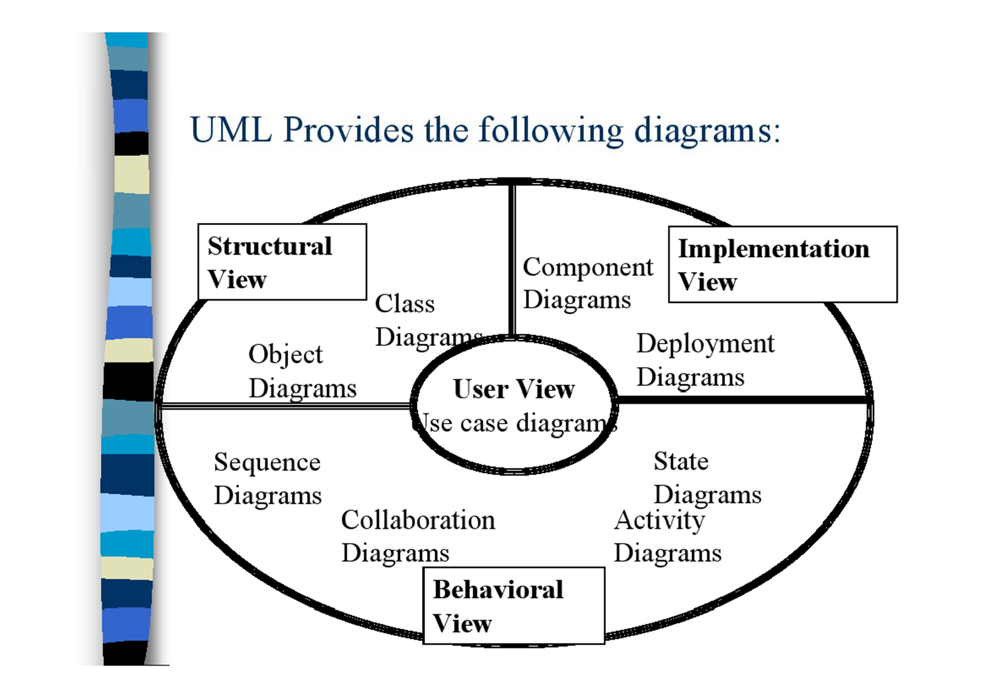
UML Provides the following diagrams/Views

Slide 3
UML: Unified Modeling Language
Expressive
Easy to use
Unambiguous
Supported by suitable tools
De facto standard for O.O. design
Not tied to any particular process

Slide 4
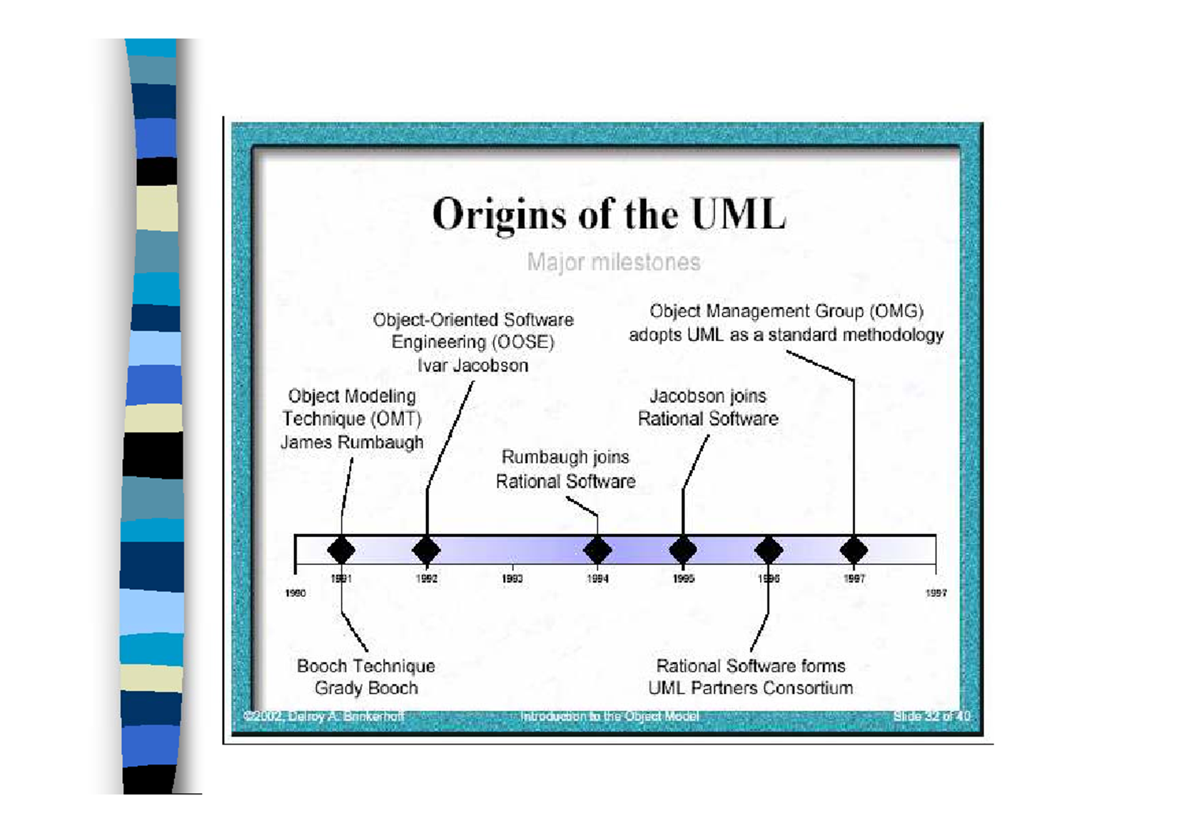
Origins of the UML

Slide 5
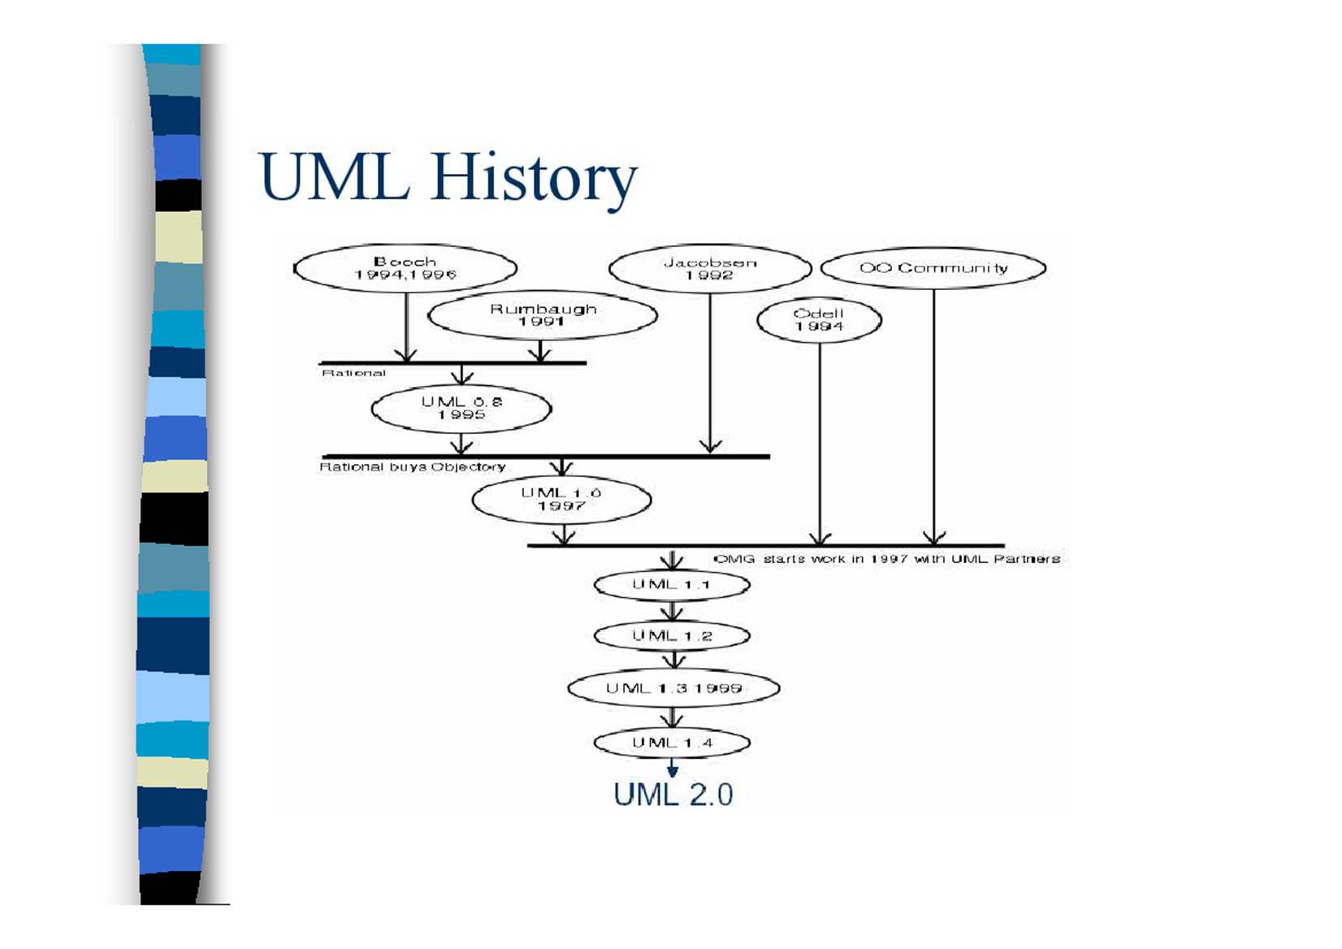

Slide 6
An Overview of UML Diagrams

Slide 7
The UML provides many different models of a system. The following is a list of them
Use Case Diagram
Class Diagram
Collaboration Diagram
Sequence Diagram
State Diagram
Package Diagram
Component Diagram
Deployment Diagram

Slide 8
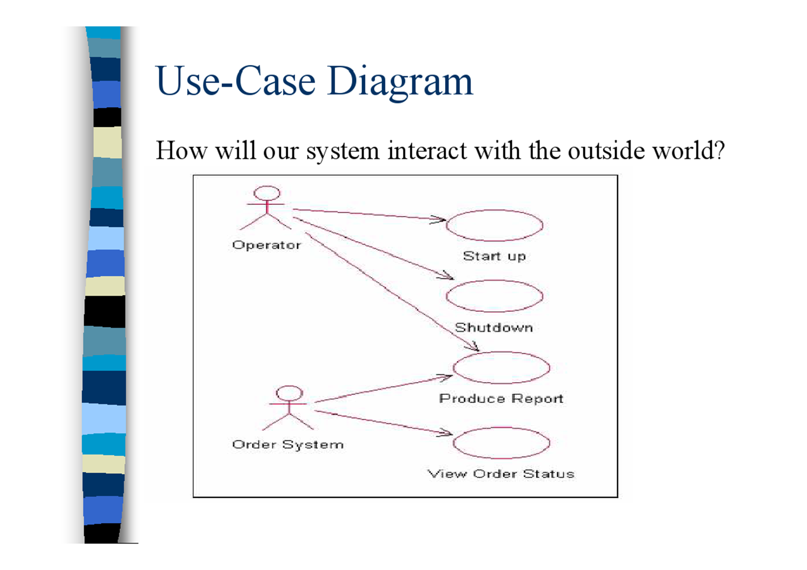
Use-Case Diagram
How will our system interact with the outside world?

Slide 9
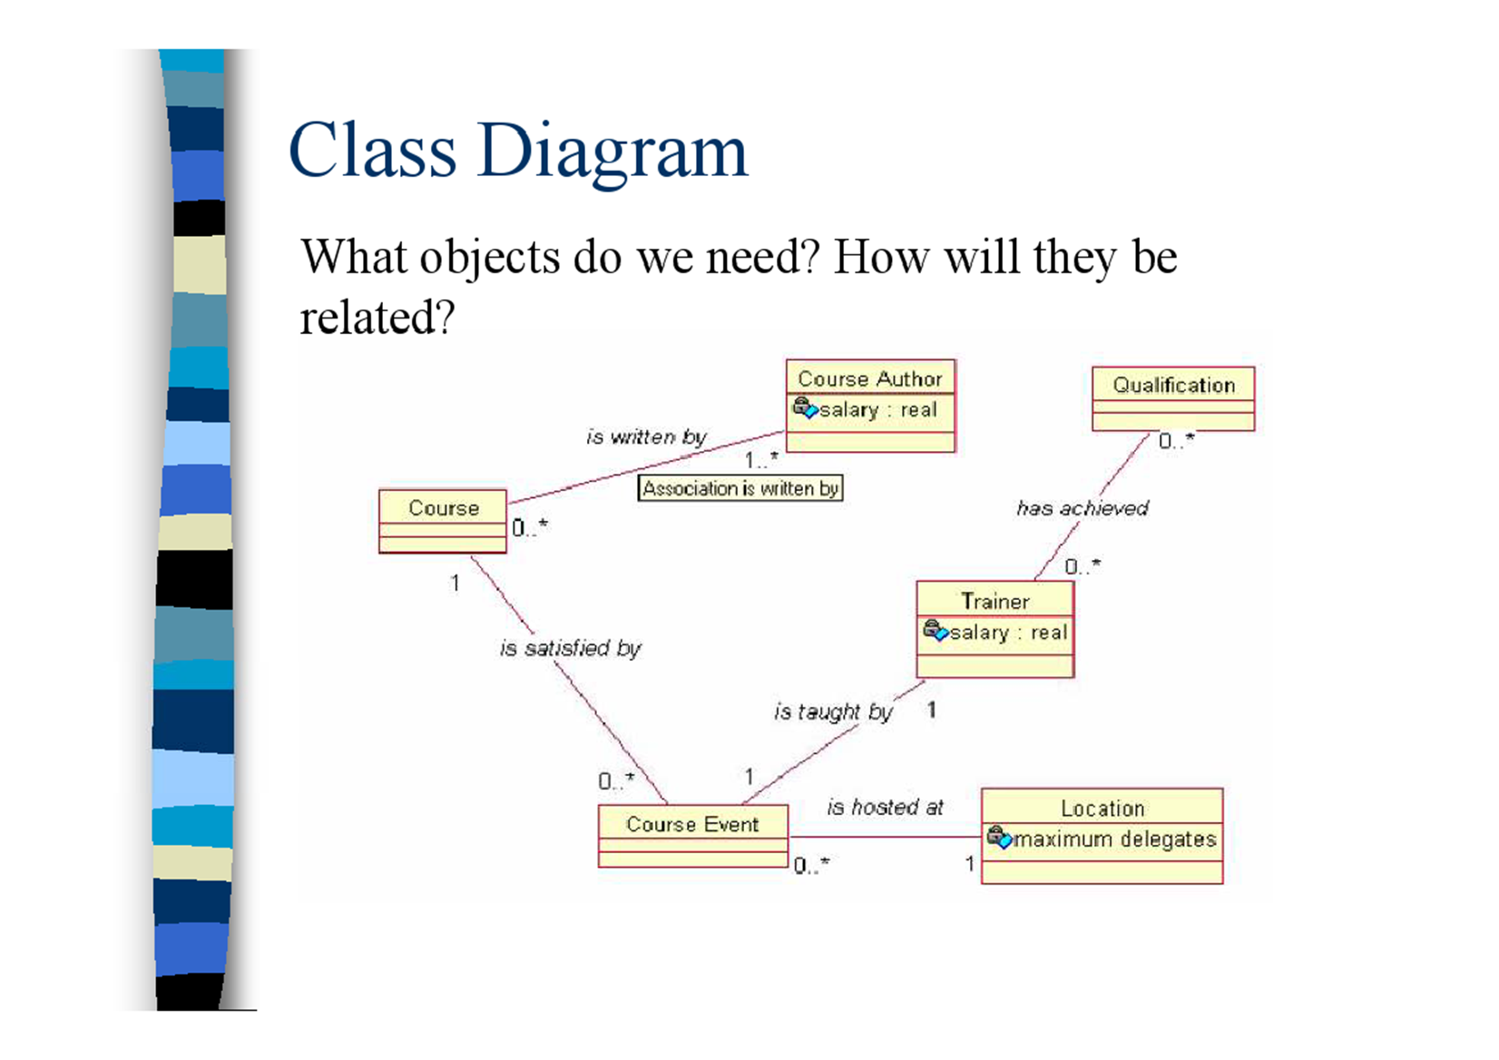
Class Diagram
What objects do we need? How will they be related?

Slide 10
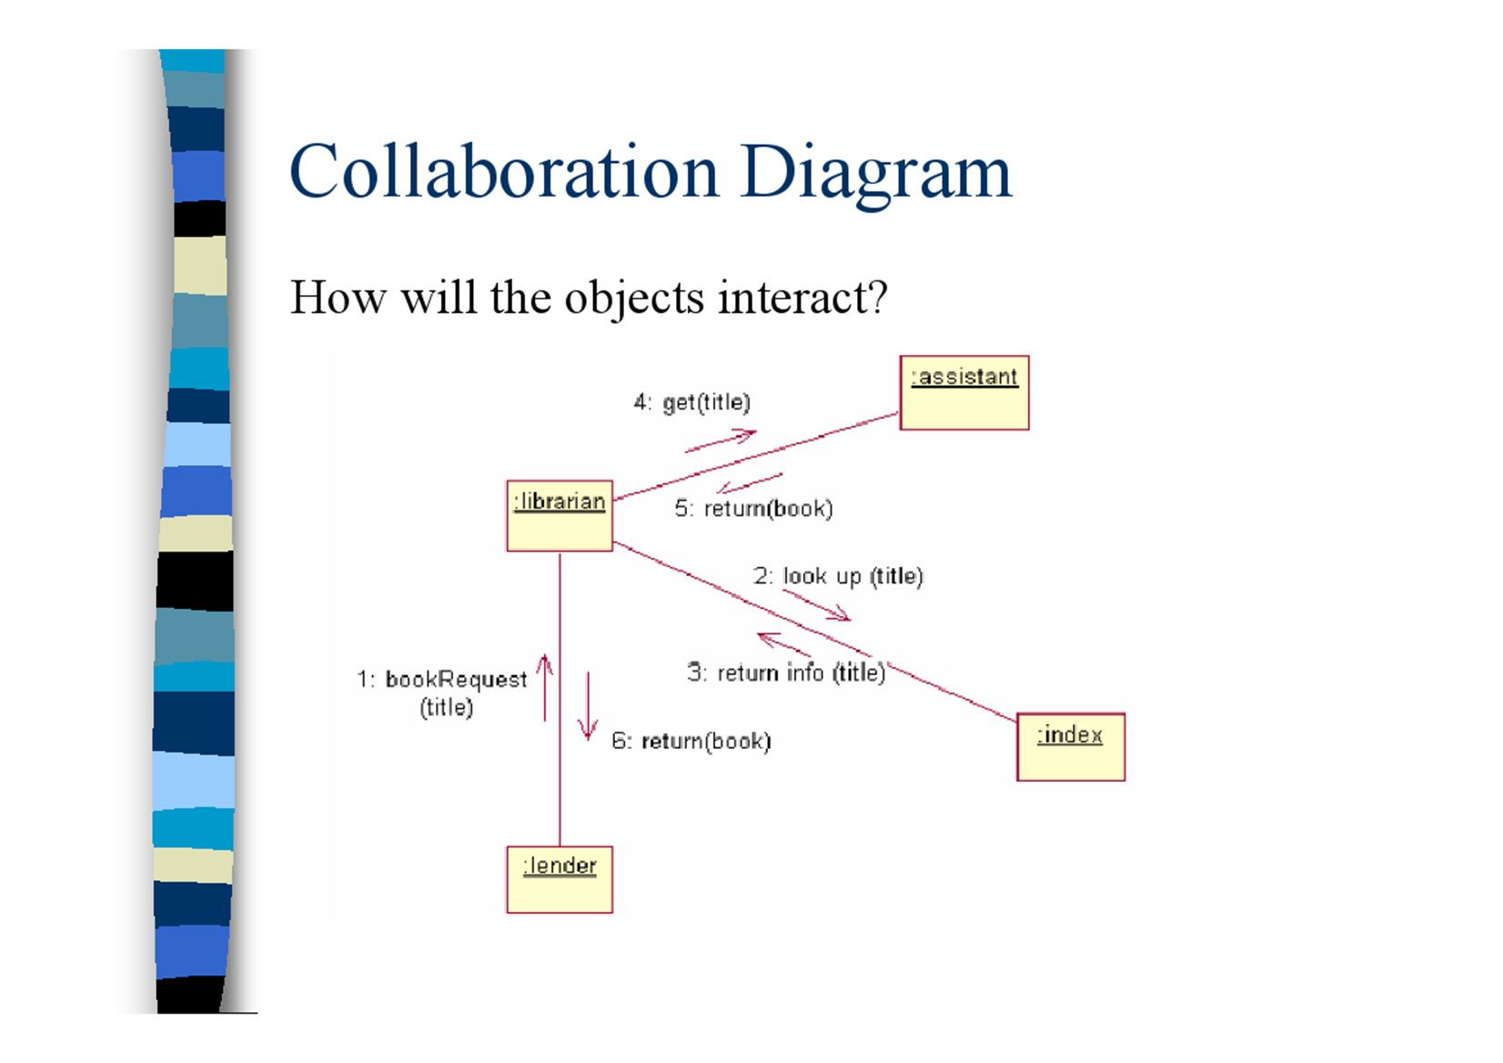
Collaboration/Communication Diagram
How will the objects interact?

Slide 11
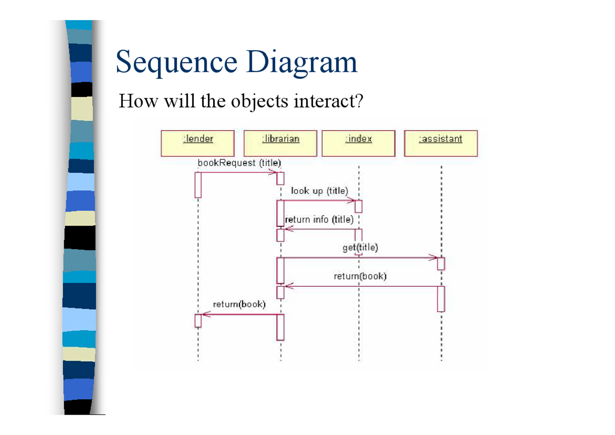
Sequence Diagram
How will the objects interact?

Slide 12
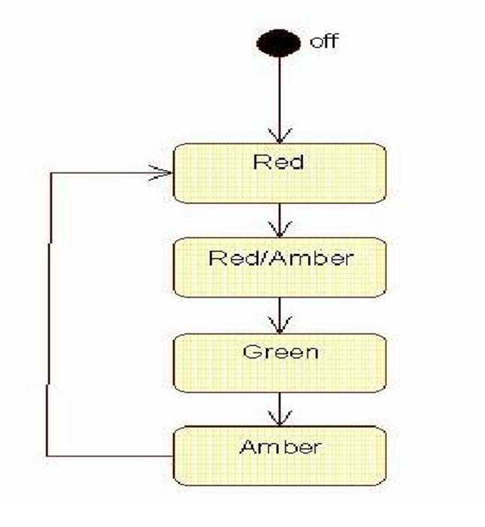
State Diagram
What states should our objects be in?

Slide 13
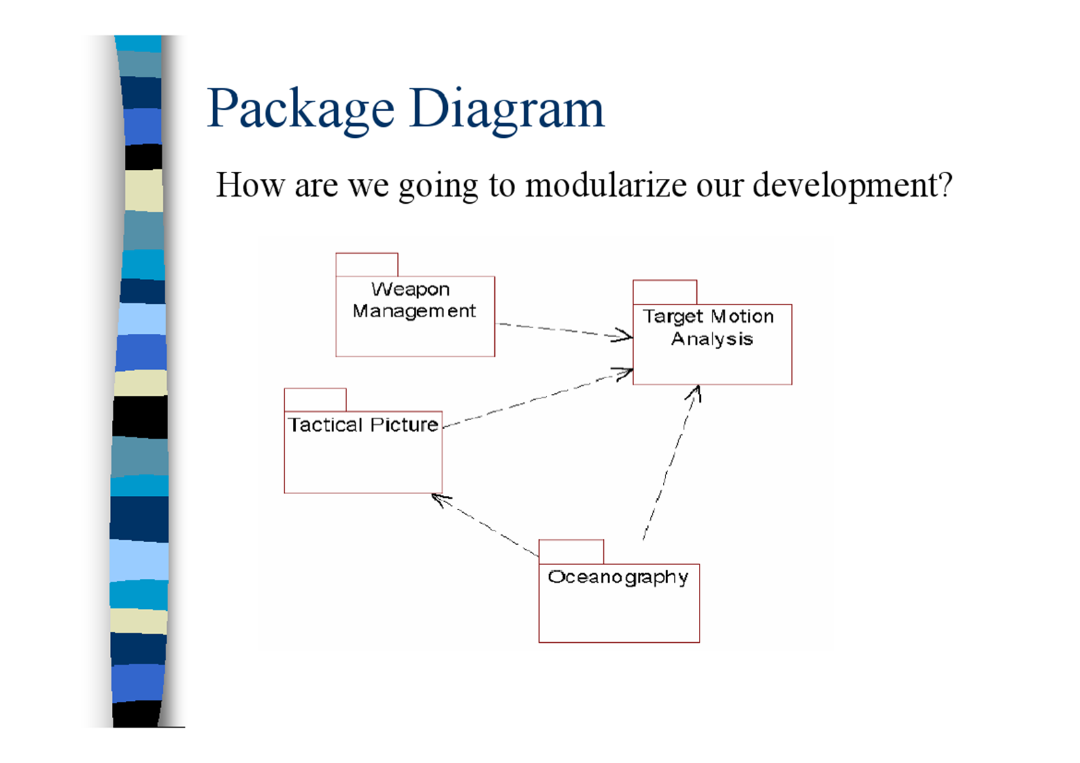
Package Diagram
How are we going to modularize our development?

Slide 14
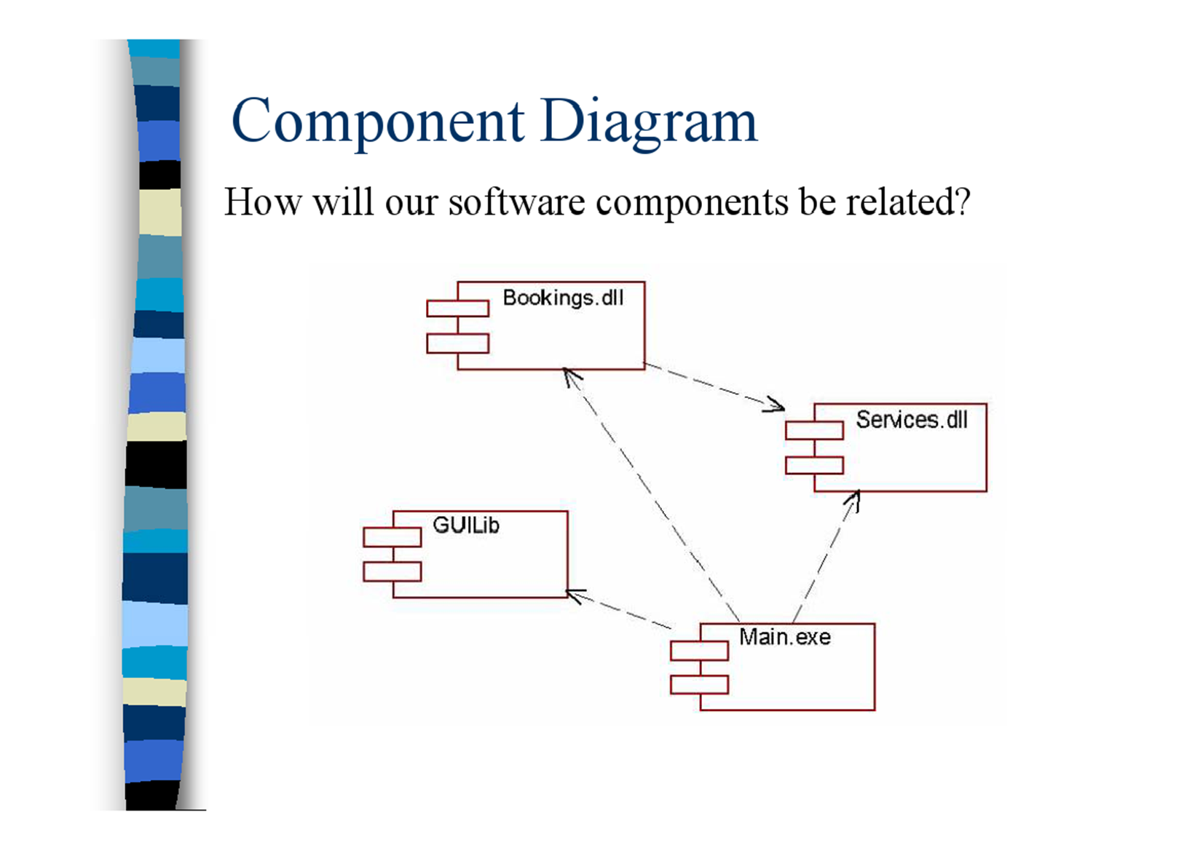
Component Diagram
How will our software components be related?

Slide 15
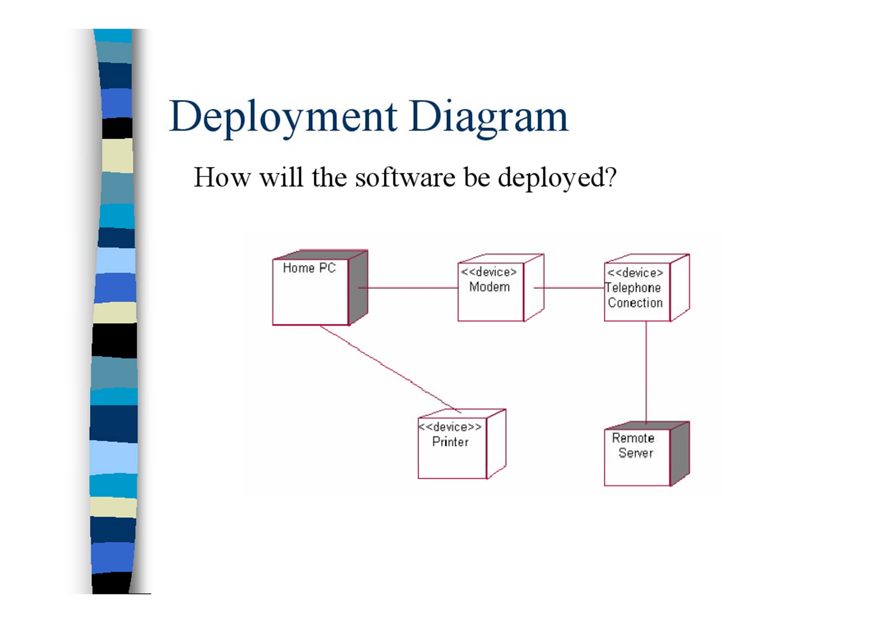
Deployment Diagram
How will the software be deployed?

Slide 16
USE-CASE MODELS IN UML

Slide 17
User Requirements
Produce a requirements definition document (the system behavior)
Produce a prototype (the user view)
Using both of the above as input to generate USE Case Scenarios

Slide 18
Example: A customer account scenario
The customer requests an account by submitting the account application.
The clerk creates a pending customer account with an account owner and default rental restrictions by entering account, account holder and account restriction information from the account application.
A credit card is associated with the account by the clerk entering the credit card information

Slide 19
Example: A scenario
4. The credit card number and expiration date are
verified with the credit card company to determine
validity.
5. An account number is obtained from the corporate office.
6. Account information is updated. The account number is assigned to the account and account status is changed to active. Status date is set to current date.
7. Clerk enters all customers associated with the account and the restrictions for each customer.

Slide 20
Purpose of the Technique
They are used to model sequences of actions that are carried out by the system and that provide an observable result to someone or something outside the system, known as an actor.
They provide a high level view of what the system does and who uses it.
They provide the basis for determining the human computer interfaces to the system.
They can be used to model alternative scenarios for
specific use cases that may result in different sequences of actions.
They use a simple diagrammatic notation that is comprehensible to end users and can be used to communicate with them about the high-level view of the system.

Slide 21
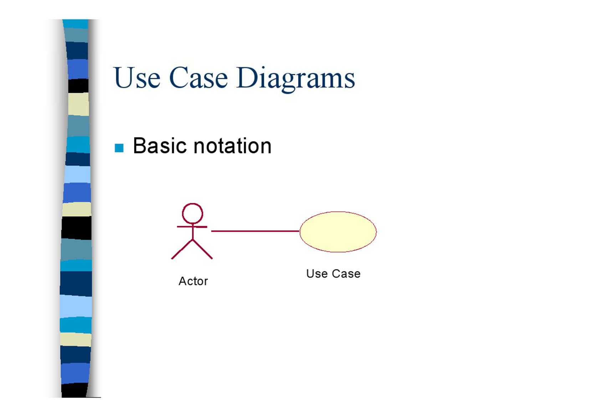
Use Case Diagrams
Basic notation

Slide 22
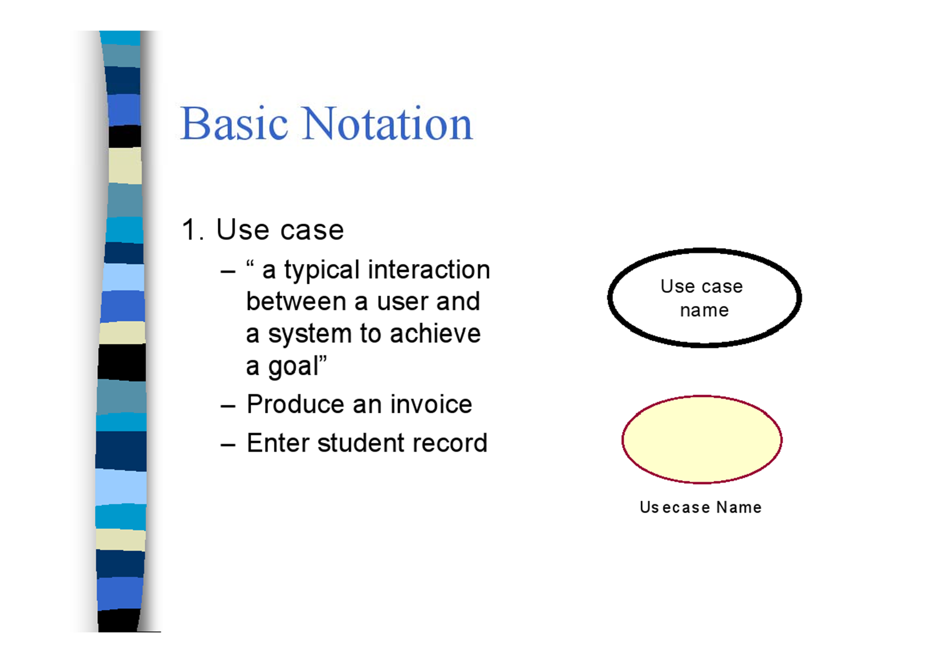
Basic Notation
1. Use case
“ a typical interaction between a user and a system to achieve a goal”
Produce an invoice
Enter student record

Slide 23
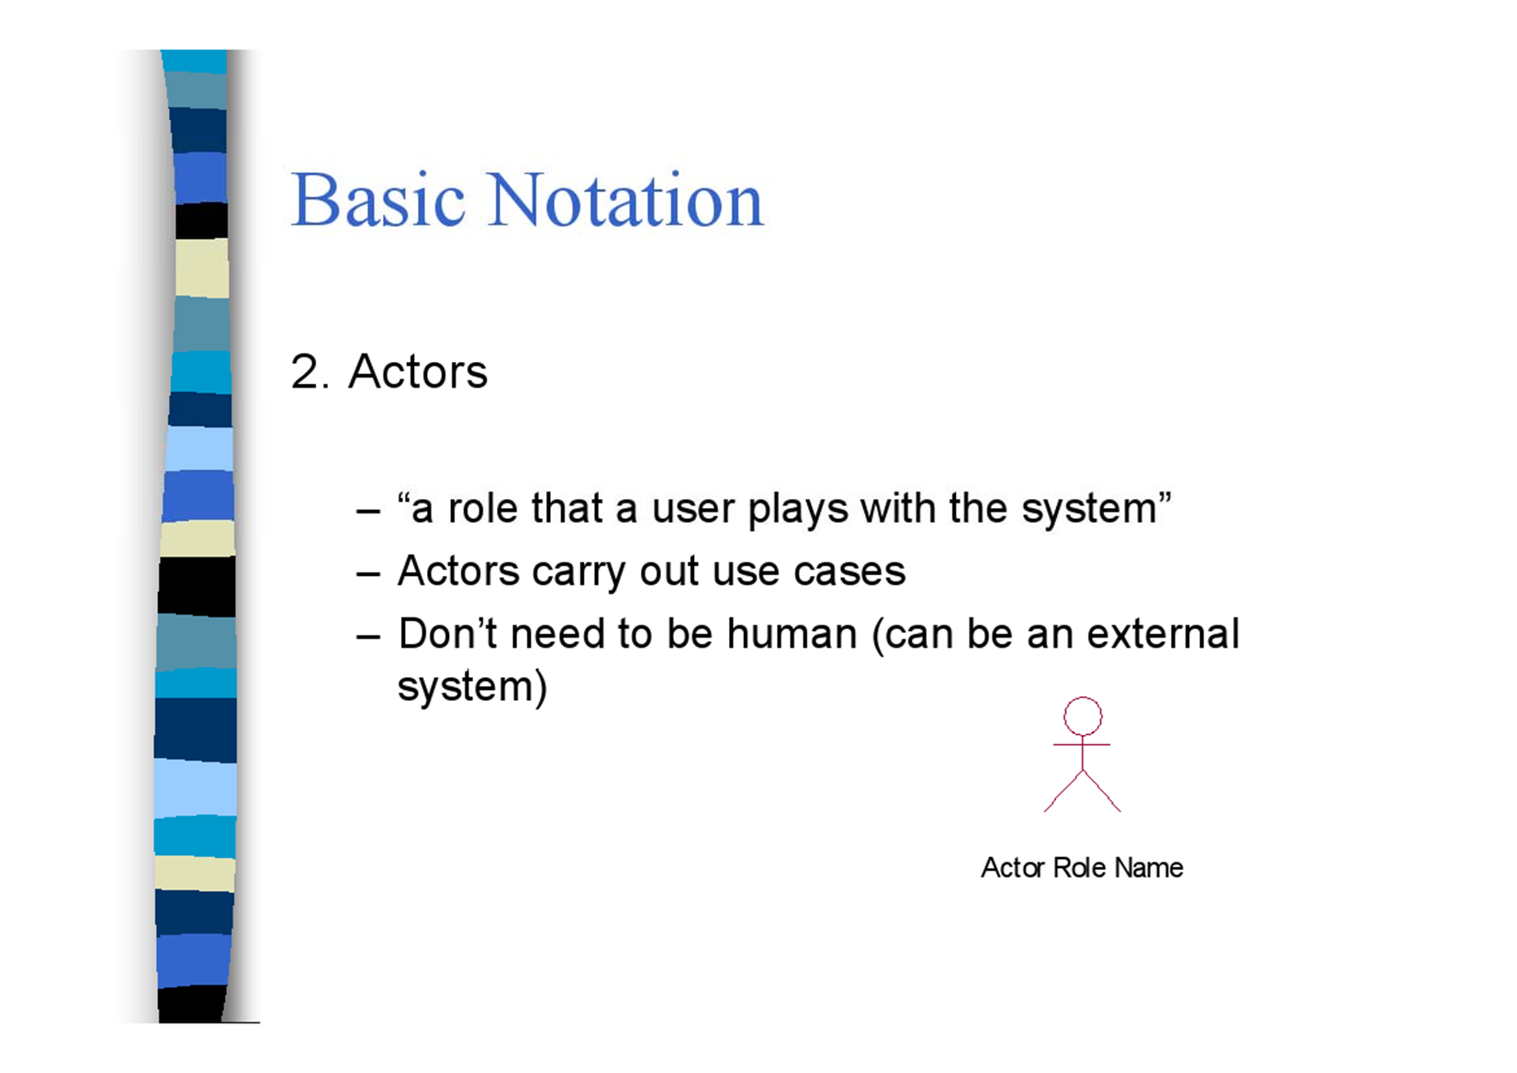
Basic Notation
2. Actors
"a role that a user plays with the system"
Actors carry out use cases
Don't need to be human (can be an external system)

Slide 24
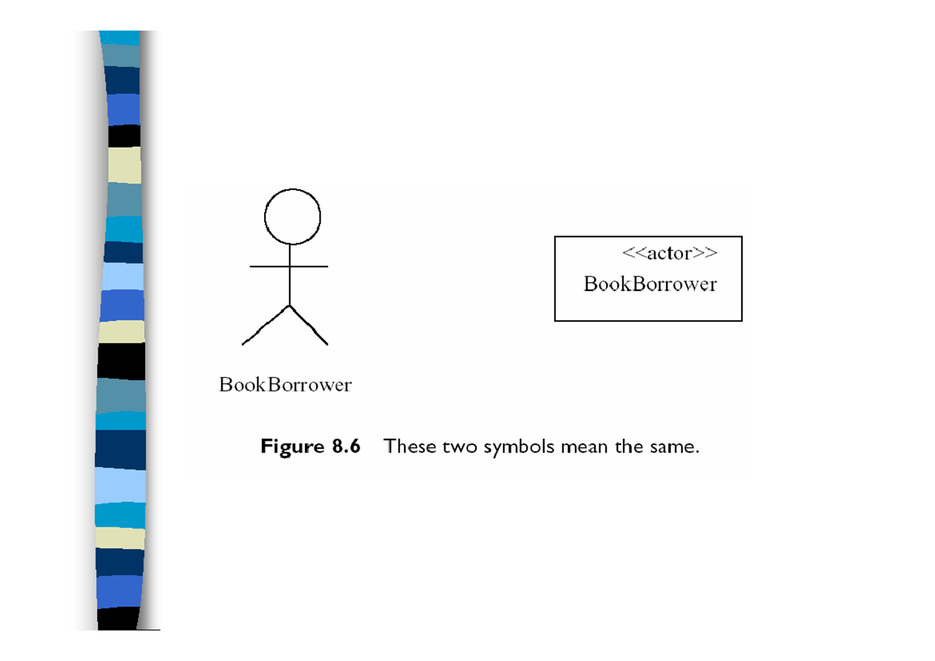

Slide 25
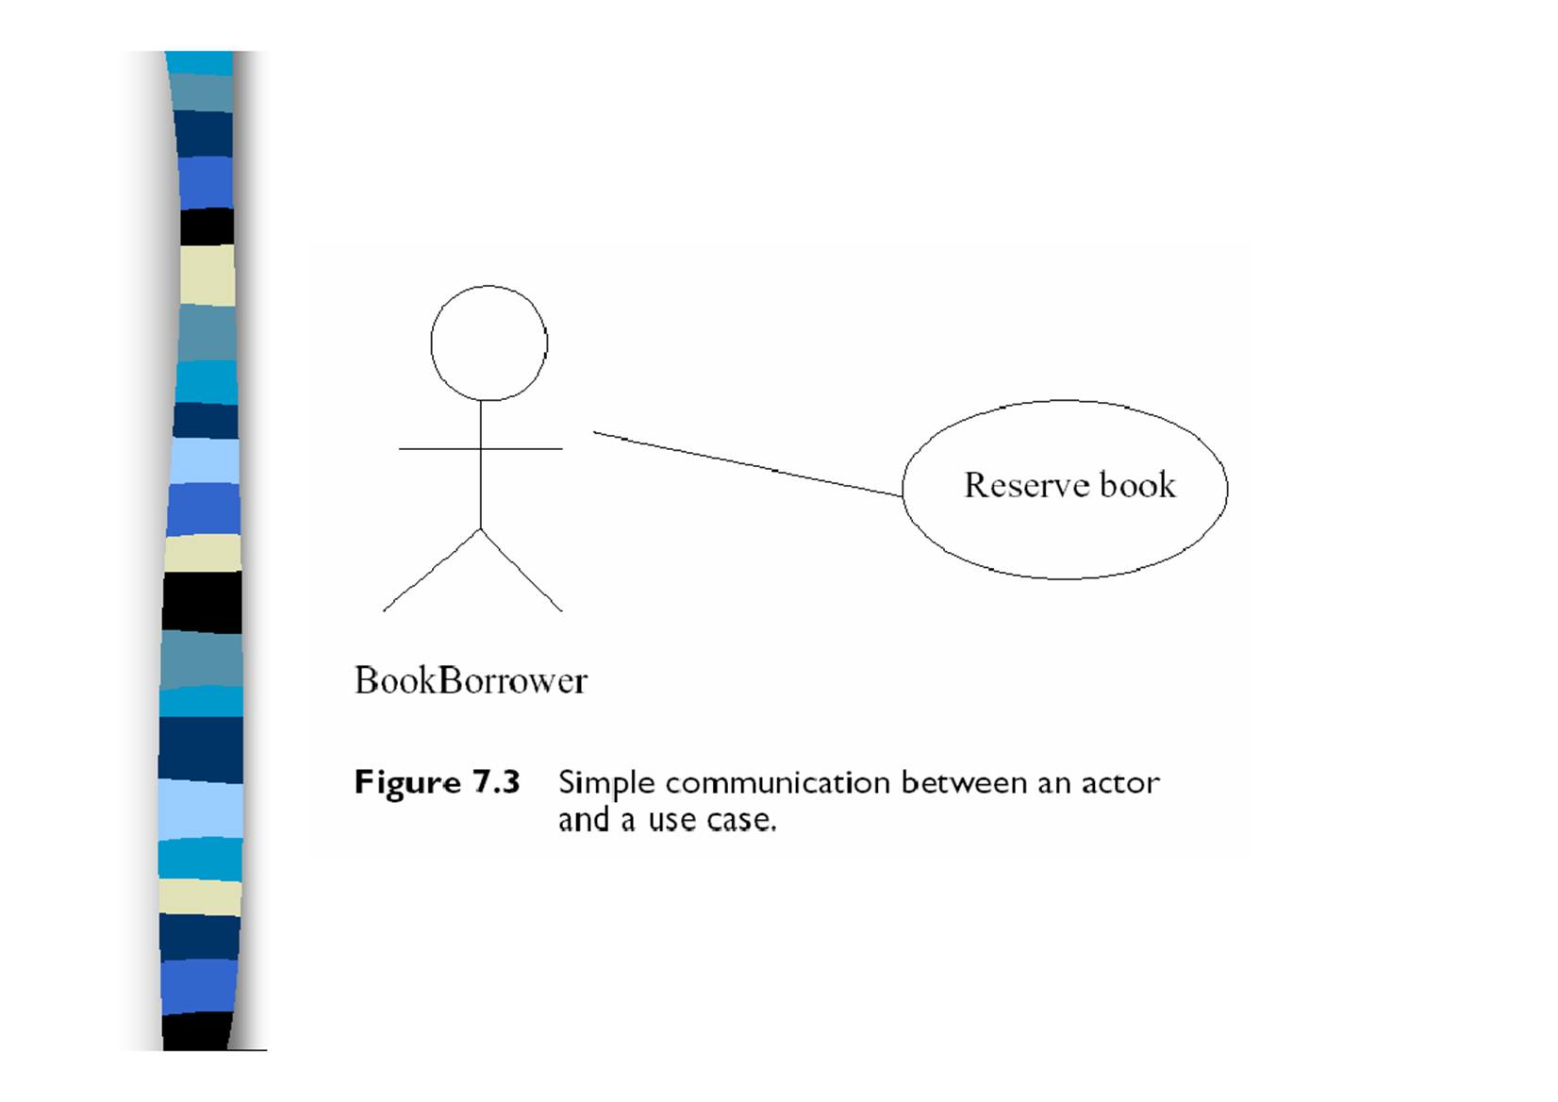

Slide 26
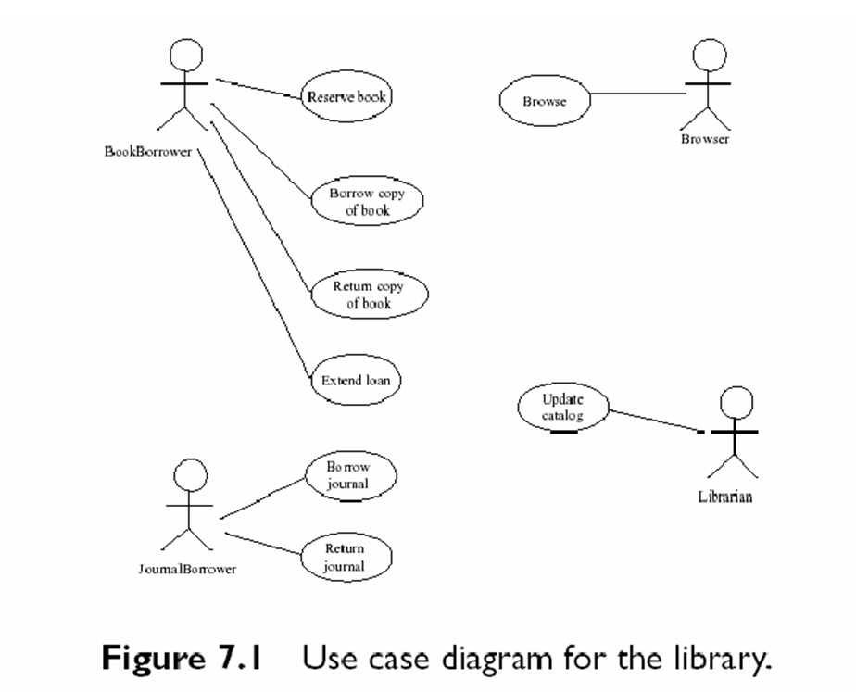

Slide 27
Use-Case Relationships
There are four other types of association or relationship that can be shown in a use case diagram. These are:
- Include relationship between use cases
- Extend relationship between use cases
- Generalization between use cases
– Generalization between actors

Slide 28
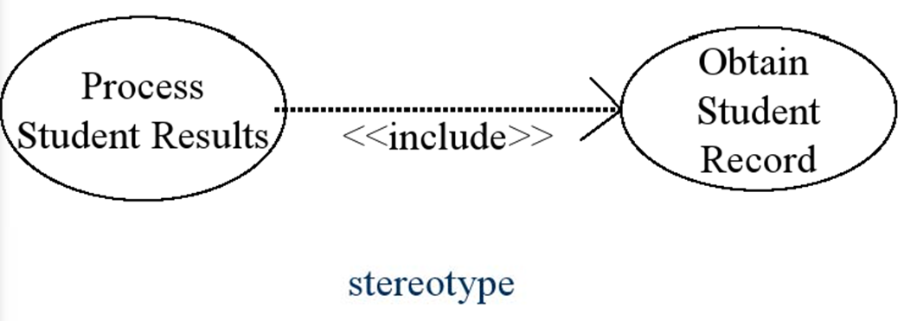
The ‘Includes' Relationship
The various USE Cases are ordered to show the ordering of the various functions in a scenario

Slide 29
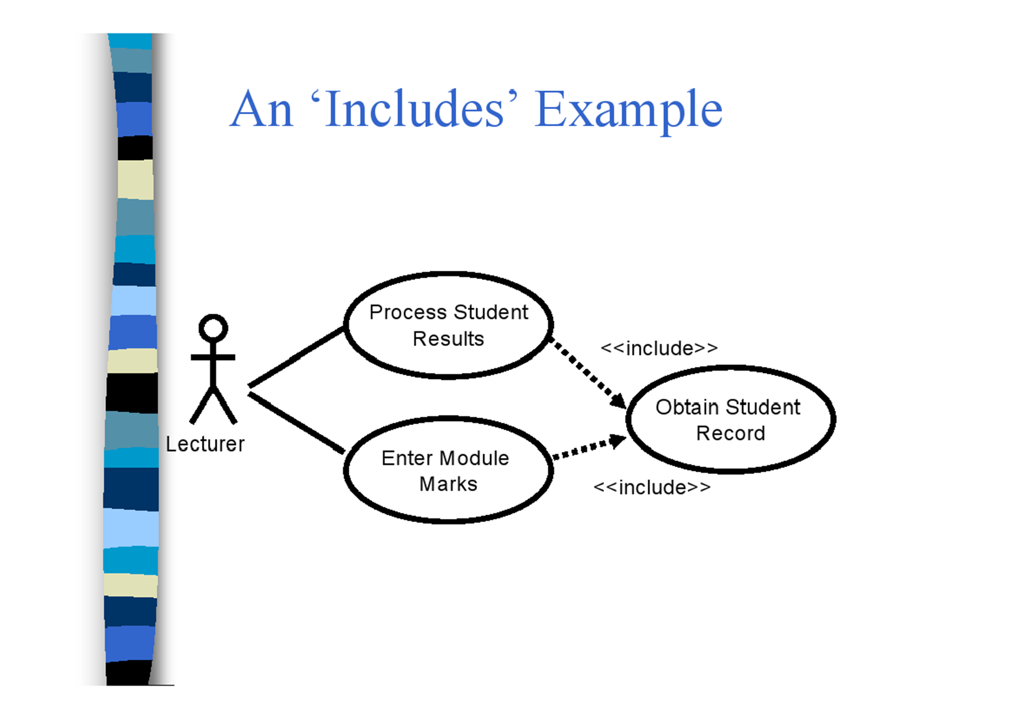
An ‘Includes’ Example

Slide 30
The “Extend” Relationship
If use-case incorporates two or more significantly different scenarios, we can separate them as a main case and subsidiary cases.
The arrow goes from the subsidiary to the main case.
We show the condition and the point at which it applies for the subsidiary case.

Slide 31
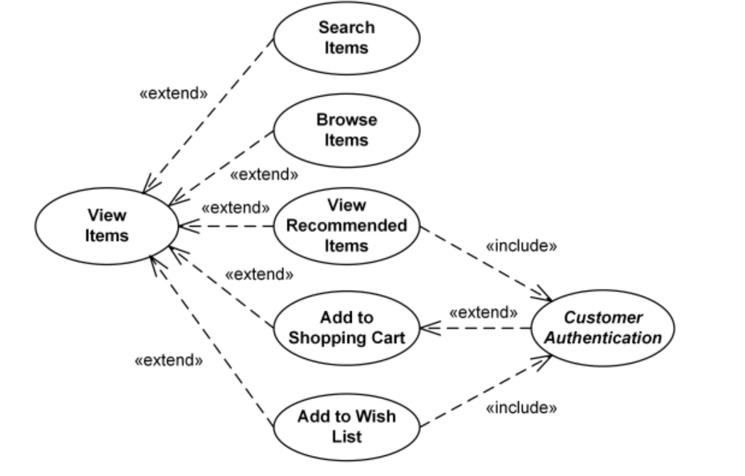
The “Extend Relationship

Slide 32
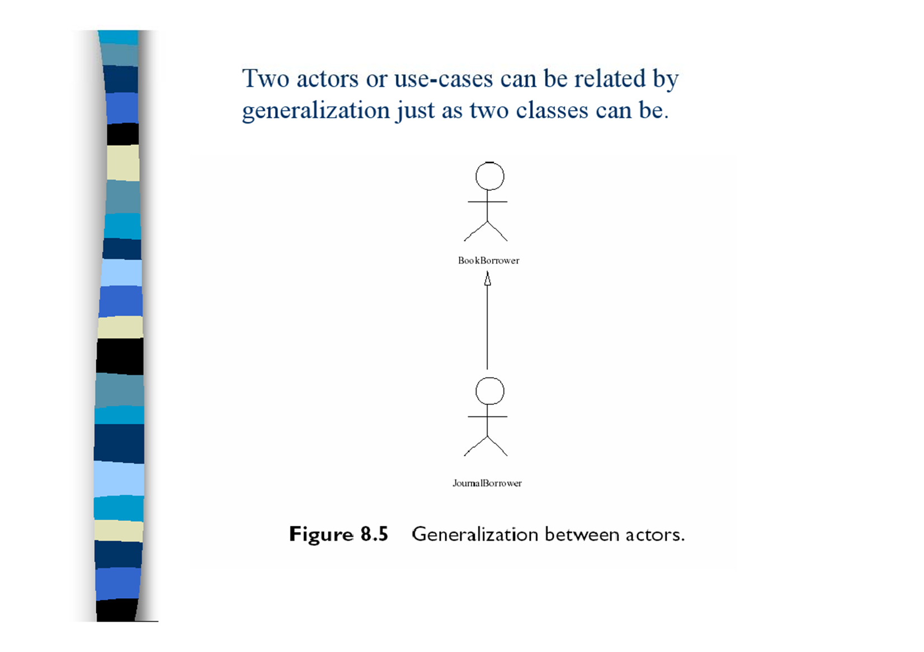
Two actors or use-cases can be related by generalization just as two classes can be.

Slide 33
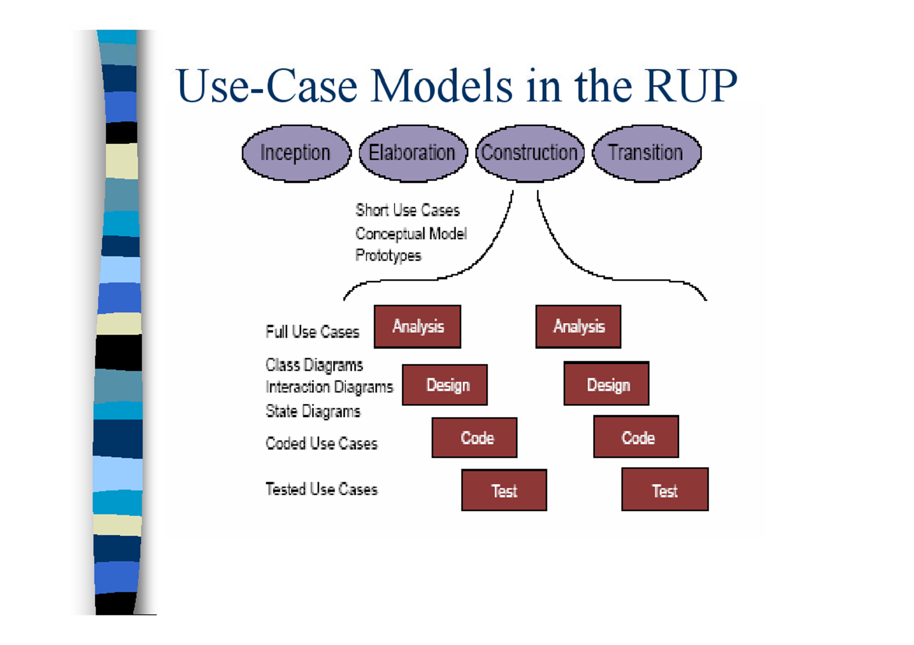
Use-Case Models in the RUP

Slide 34
Use-case Documentation (Detailed Specifications)
Record the detailed information about what a use-case involves (behavior specifications):
What are the possible scenarios and
What determines which of them applies in any given set of circumstances?
This is usually done by associating
-a scenarios script: textual description with the use-case.
A UML activity diagram or an interaction diagram
some formal language may also be used.

Slide 35
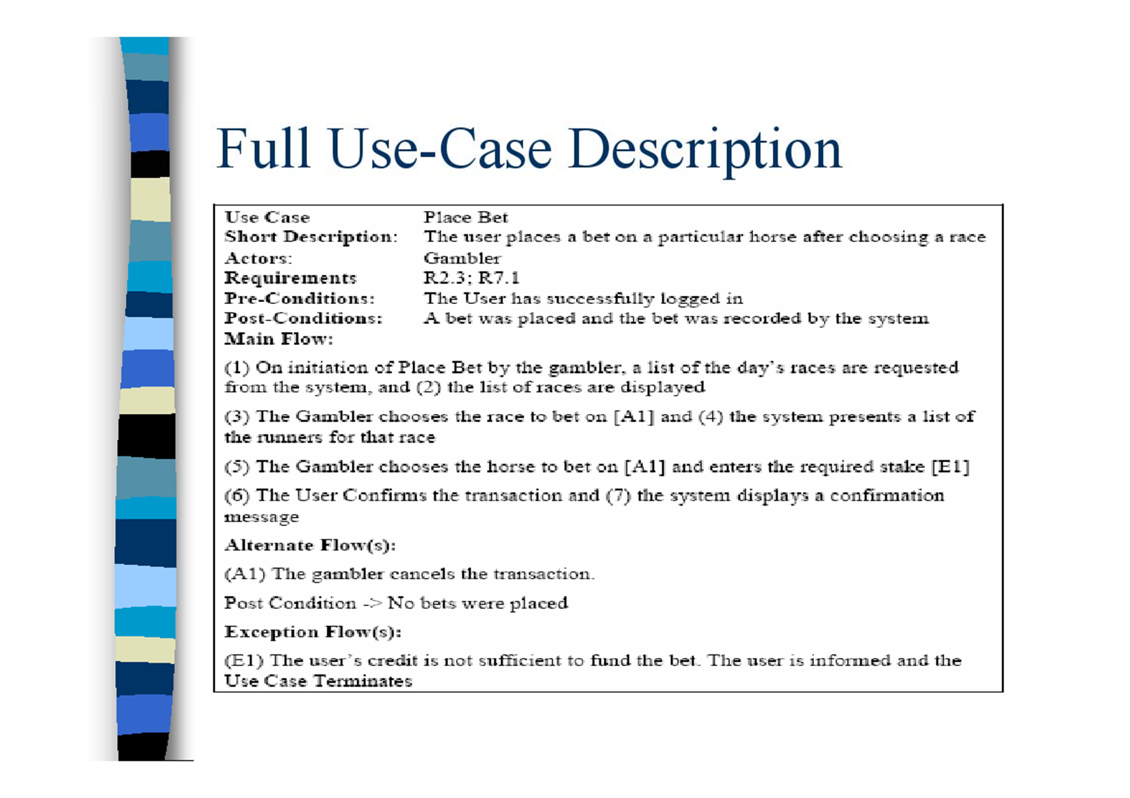
Full Use-Case Description

Slide 36
How to Produce Use Cases (Capturing Requirements in RUP)
Identify the actors
For each actor, find out (use cases)
what they need from the system (what use cases have value for them)
any other interactions they expect to have with the system (which use cases they might take part in for someone else's benefit)
Prioritize use cases
- how much someone needs a given use case to be realized.
Develop each use case starting with the priority ones.
- produce the detailed specifications of each use case.
Structure the use case model

Slide 37
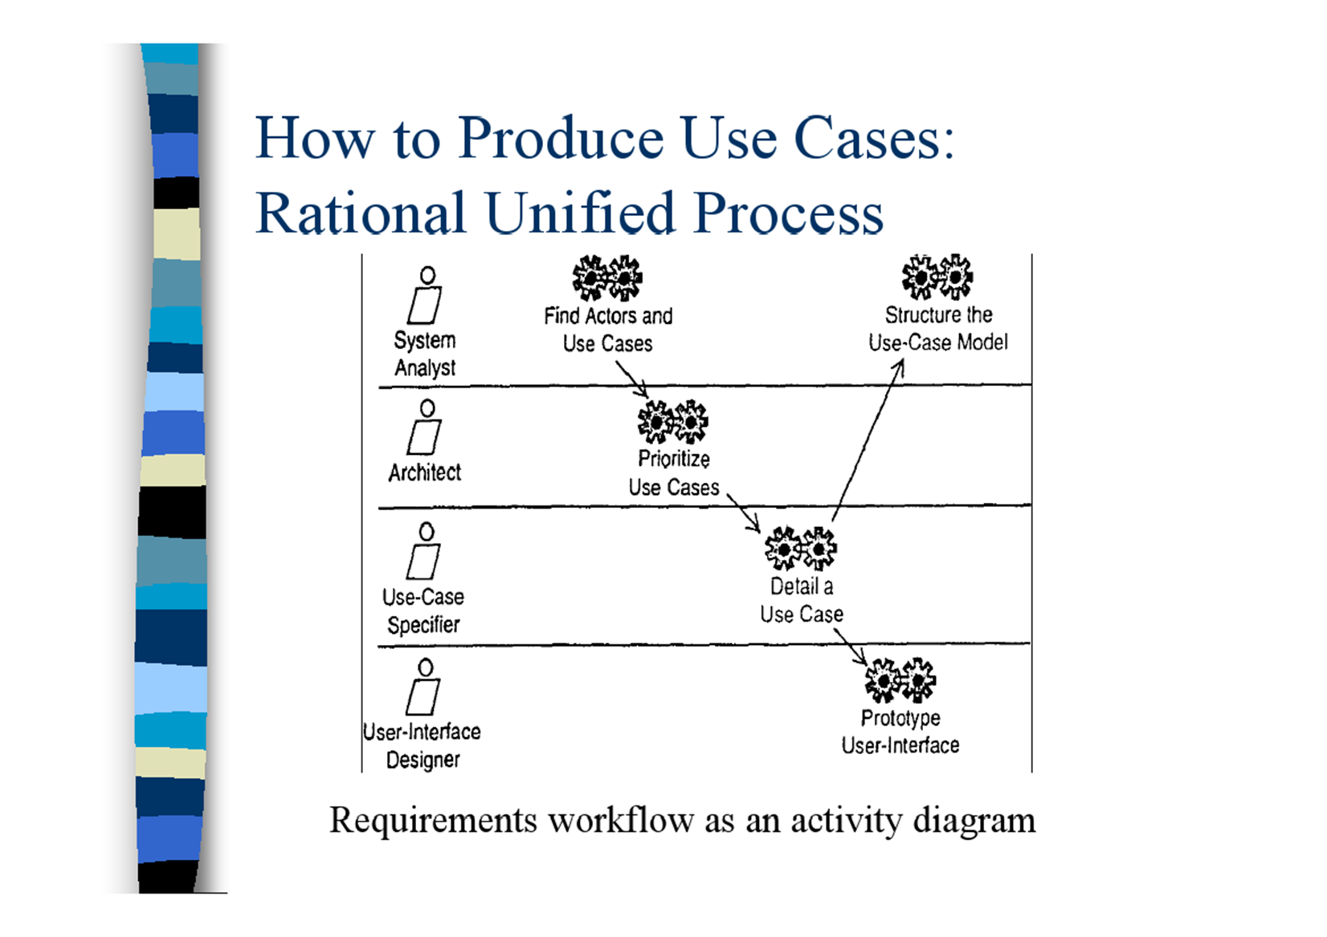
How to Produce Use Cases: Rational Unified Process

Slide 38
1- Find Actors and Use cases
By Analysis the requirement using different techniques.
One of the main tools is to use Context Diagram

Slide 39
2. Prioritize Use Cases
The purpose of this is to ensure that the important use cases are developed in early iterations of the next activity.
EXAMPLE
Of the use cases listed in the previous example,
- getting the details of car sharers into the system in the first place and
- matching them up
are probably more important than
- producing management reports,
and they would be the priorities for further elaboration

Slide 40
3. Develop each Use Case
The purpose of this activity is
to produce the detailed specification of each use case.
It may also result in new use cases coming to light.
In the Unified Process there is a staff role for,
– Use Case Specifiers, people who produce the detailed step by step specification of use cases.
In most projects,
- it is likely to be a systems analyst who is carrying out this role.

Slide 41
4. Structure the Use Case Model
In this activity structure will be added to the use case diagram through the use of generalization, include and extend relationships and through the grouping of use cases in packages.

Slide 42
System Boundary
Optionally, there can be a box around the use case diagram, labeled with the name of the system
This can be useful when modeling a complex system which is split into different subsystems (each diagram may represent a subsystem).

Slide 43
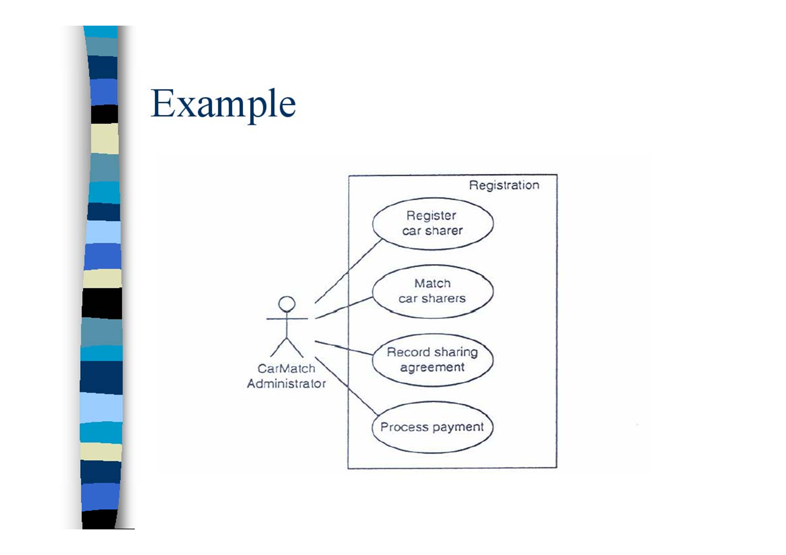
Example

Slide 44
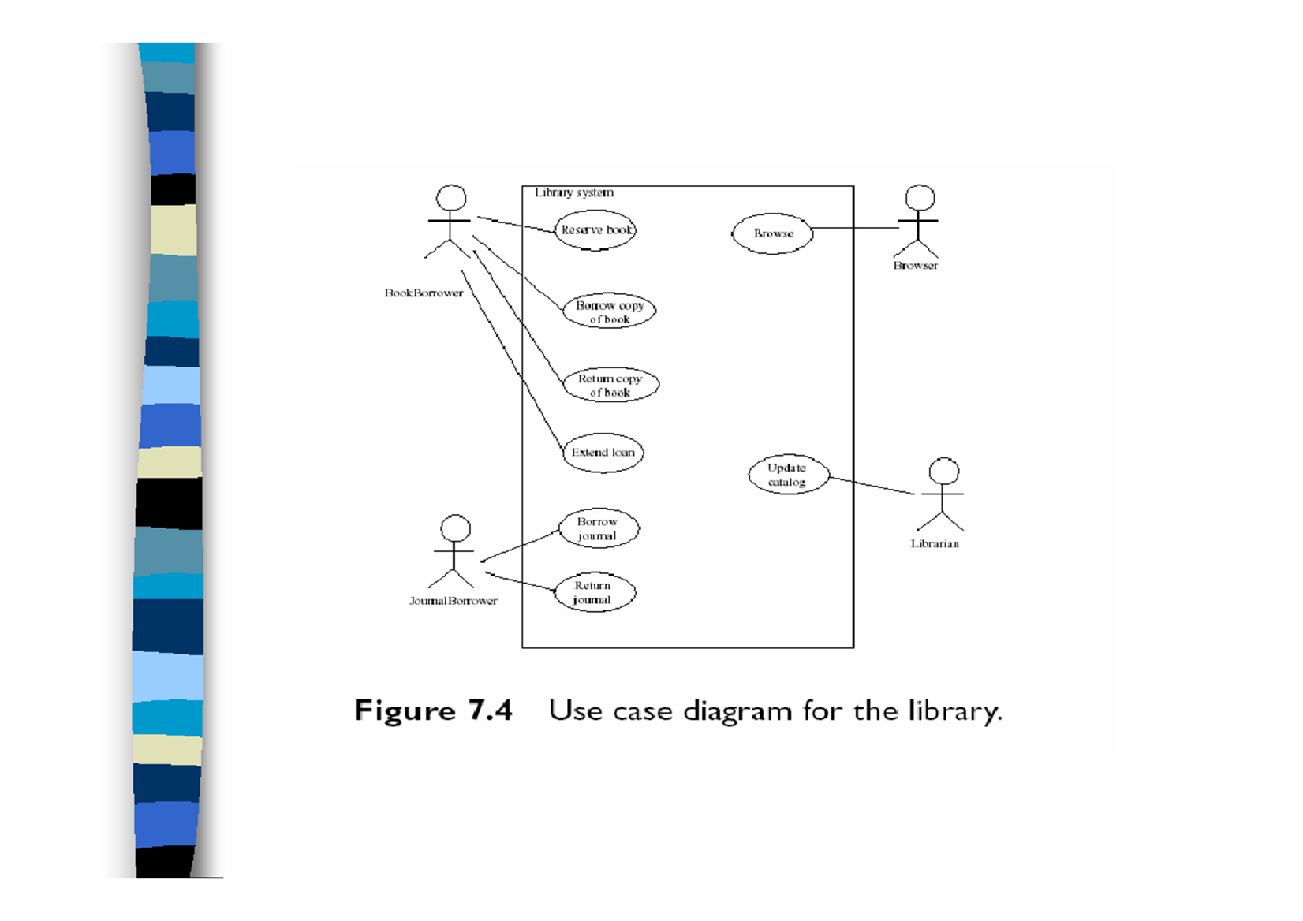

Slide 45
Packages
The means by which a number of closely related USE Case scenarios are ‘packaged together to form a complete sub-system
You can use the package idea to 'box' the corresponding class diagram as well as USE Cases.

Slide 46
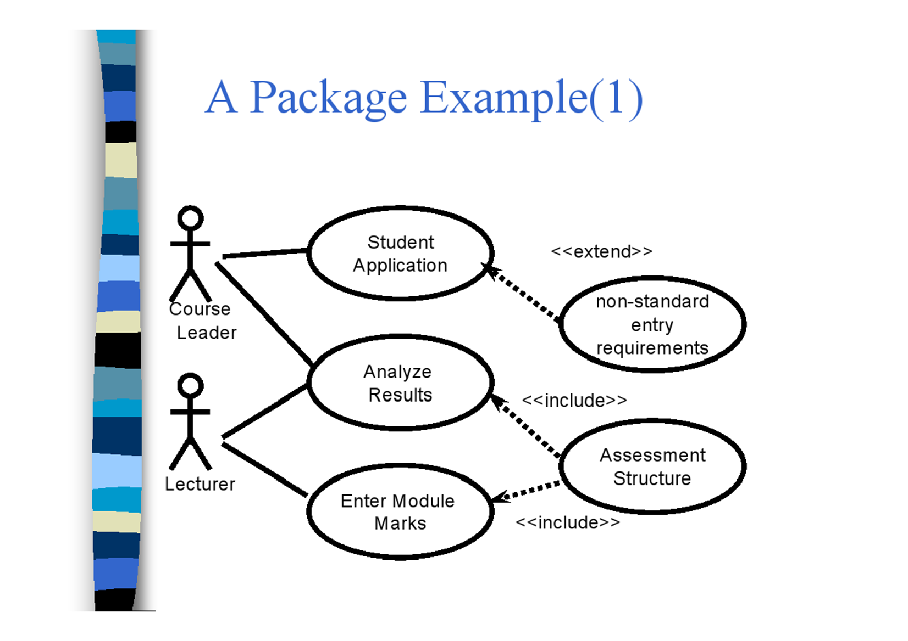
A Package Example(1)

Slide 47
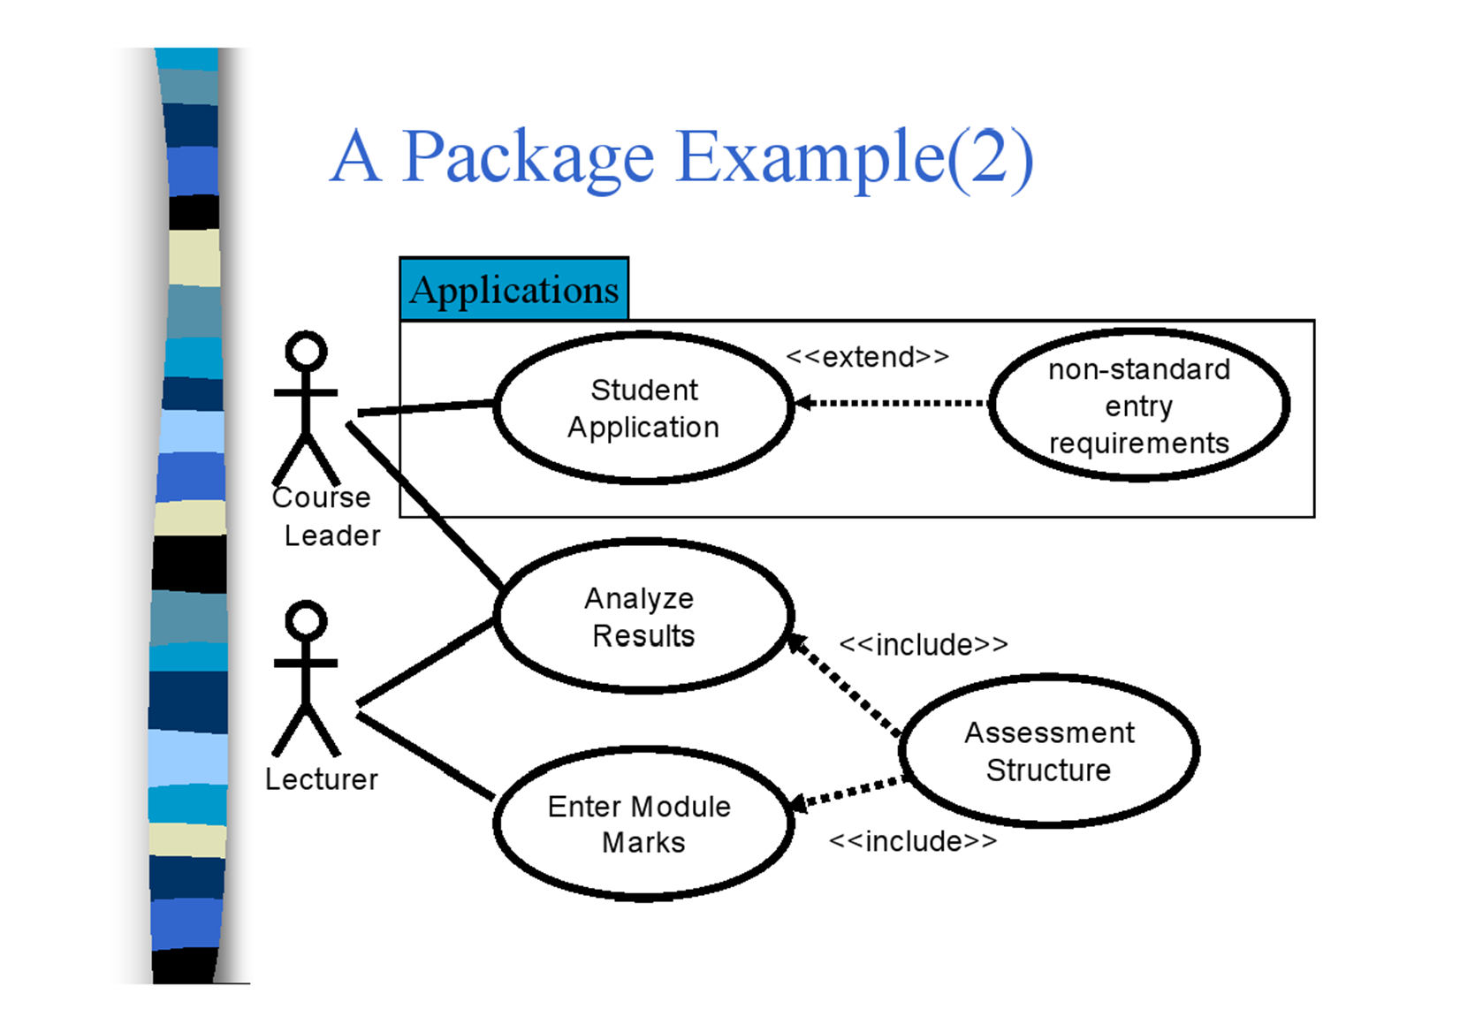
A Package Example(2)

Slide 48
Robustness Analysis
The means by which USE Cases are mapped to a Class Diagram
It is the first guess at the assumed objects required for a system.

Slide 49
Object Classification
There are 3 types of object:
Boundary Objects;
Entity Objects;
Control Objects.
Control objects are strong processing units. They may be represented by objects or may be methods of other objects.

Slide 50
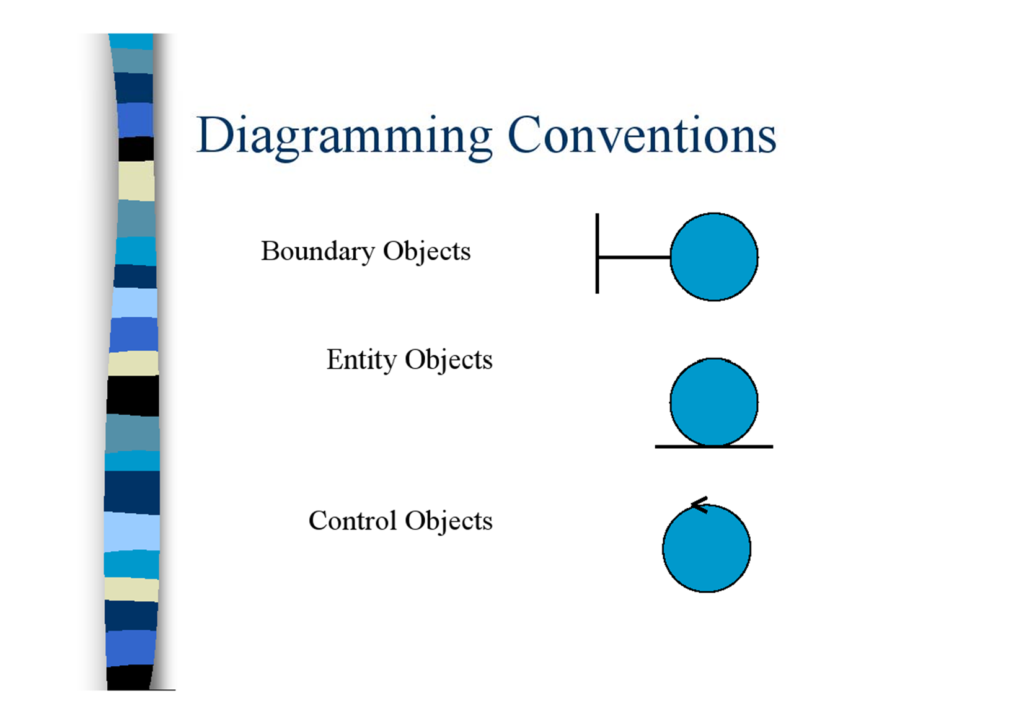
Diagramming Conventions

Slide 51
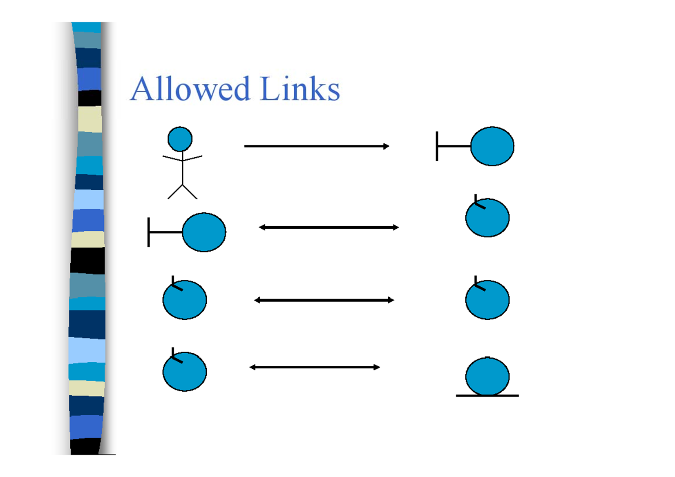
Allowed Links

Slide 52
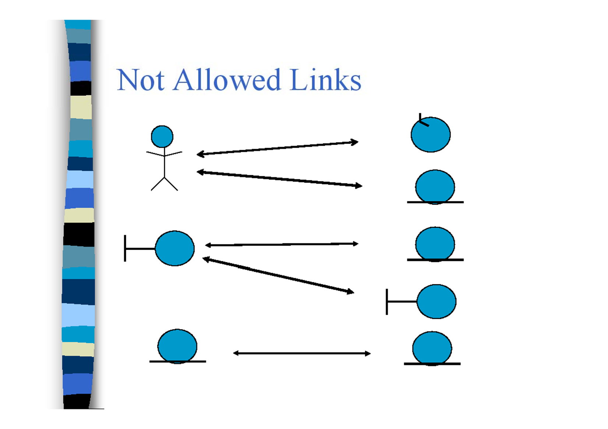
Not Allowed Links

Slide 53
Roles of Robustness Analysis
Preliminary Design - R.A. is a bridge between analysis and design.
Sanity Check - are the USE Cases reasonable?
Completeness Check - has the USE Case covered all alternative courses of action?
Discovery of New Objects - a first chance to review the initial definition of objects.

Slide 54
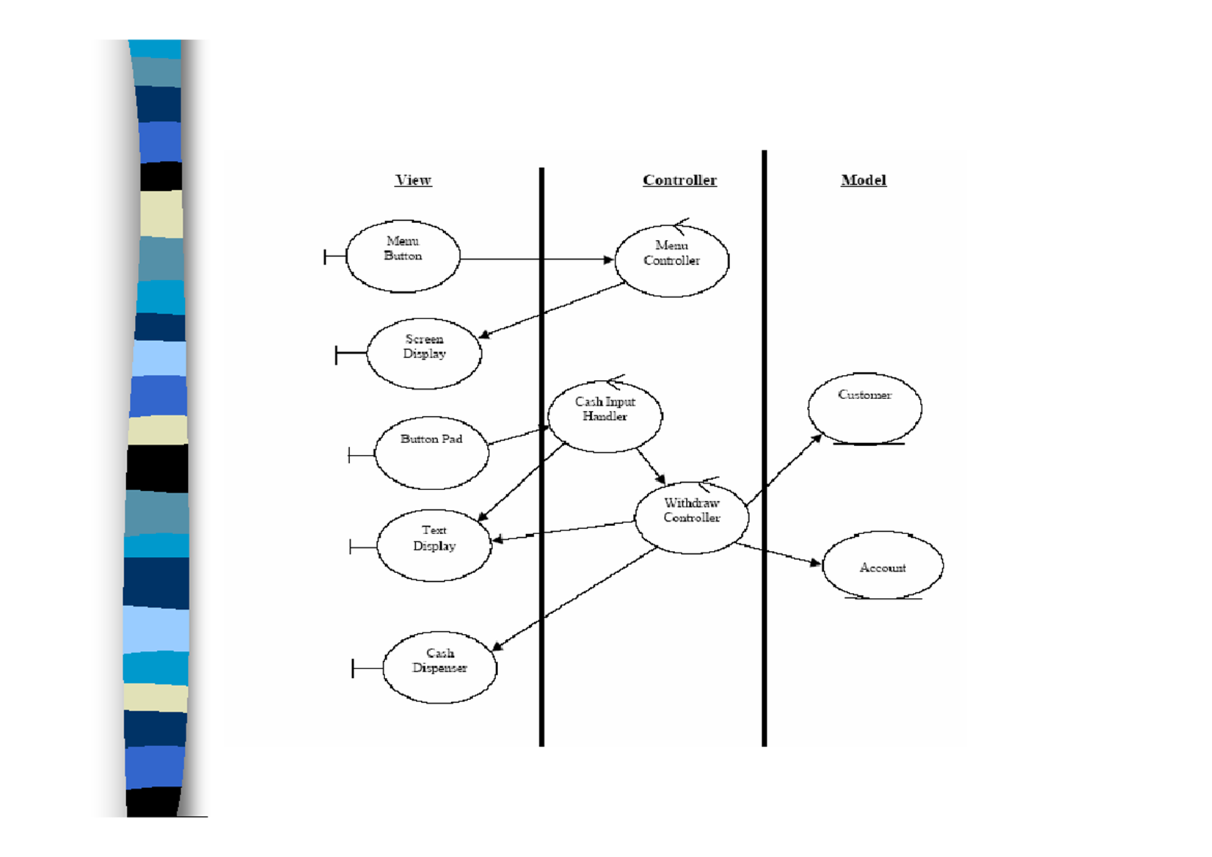

Slide 55
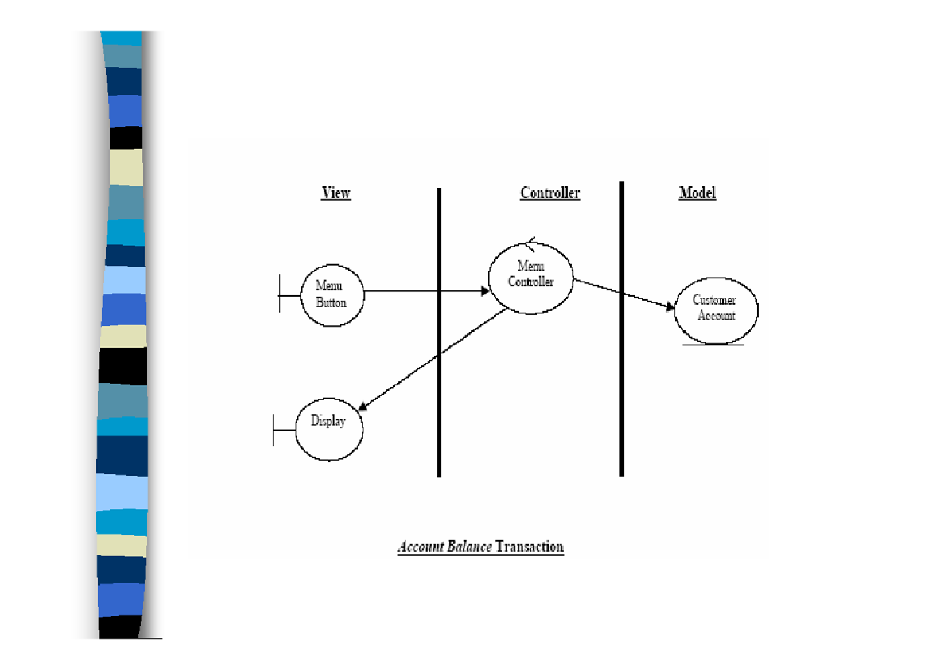

Slide 56
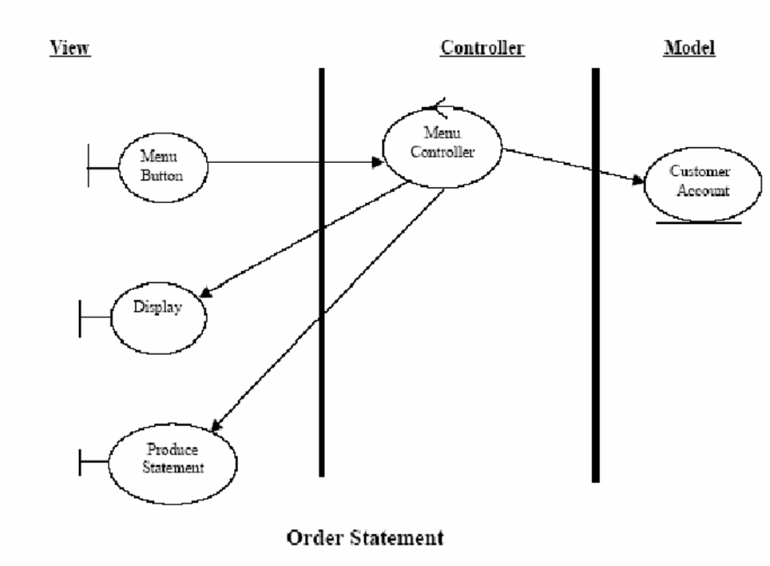

Slide 57
